Slide 1
TOPIC:HEALTH TECH
IDEA:GPS MONITORING FOR AMBULANCE
GPS tracking system gives the manager ‘live tracking ‘ of every ambulance in their fleet. Thus , when the hospital gets a call for emergency ambulance services , the manager can assign an ambulance which is nearest to the location of emergency. The time for ambulance to reach to patient can thus be minimised .

Slide 2
IDEA:GPS MONITORING FOR AMBULANCE
If there’s no backup, an ambulance should know the best way to reach the patient.GPS monitoring can assist the ambulance while they’re on the filed as well as the hospital tracking the ambulance’s location.
01
Ambulances are critical tools in helping EMTs and other trained first responders not only quickly arrive at an emergency but also provide potentially life-saving measures. So for the safety and other advantages, GPS Tracking System (ATS) is currently been applied to ambulances.
02
This solution focus to make the ambulance available to a poor patient in the shortest possible time by redirecting the ambulance from a nearby location and in a shorter way, than the conventional way of sending the ambulance all the way from hospital to a critical spot.
03
The Ambulance will be outfitted with GPS enabled Tracker devices that will gather the location coordinates from the GPS satellites and send them in real time to the focal server through GPRS enabled SIM.
04

Slide 3
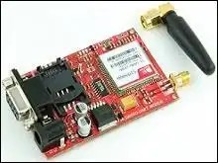
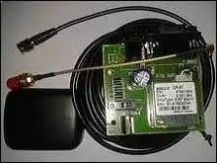
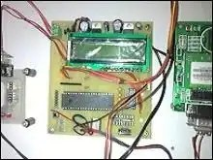
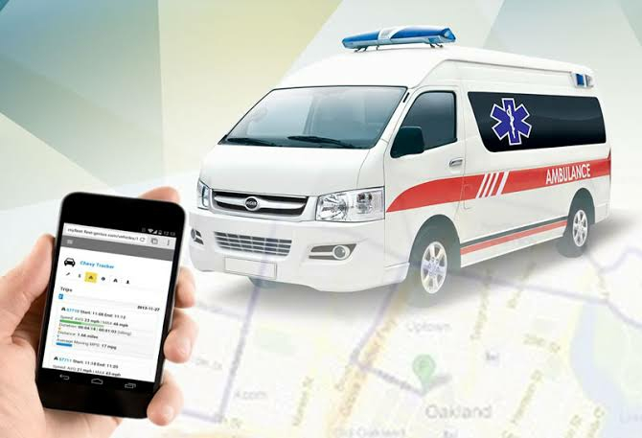

Slide 4
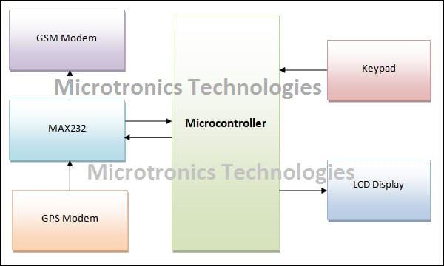

Slide 5
USE CASES:GPS MONITORING FOR AMBULANCE
01
It entails a network of 24 satellites in orbit and devices on the ground that can establish a person or object’s location on Earth with astonishing precision.
02
GPS Tracking tracks three separate data set: positioning, navigation , and timing.
03
Satellites that use microwave signals that are transmitted on location , vehicle speed , time and direction.
04
While on the road, the paramedics will navigate the best route to reach the patient, avoiding traffic and any other hindrances.

Slide 6
TECHNOLOGY STACK
Server : GPS
Notification Trigger: Twilio or push.io
STOPPER
This application will useful to avoid an ancient using GPS Monitoring , on the field hospital tracking the ambulance location.

Slide 7
THANK YOU
Insert the Subtitle of Your Presentation

